Slide 1



Blinkit Grocery Data Analysis
PROJECT MEMBER
Manikandan M [22ADR062]
Aswin K S [22ADR012] Kishore S [22ADR054]
PROJECT GUIDE
Ms.O.Abhila Anju
Associate Professor Department of AI

Slide 2
INTRODUCTION
The BlinkIT Grocery dataset serves as a comprehensive source of information to analyze key performance indicators (KPIs) within the grocery retail sector.
By analyzing this dataset, we aim to uncover insights into product performance, customer buying patterns, demand forecasting, and supply chain efficiency.
Using Power BI for this analysis will enable dynamic data visualization and facilitate a deeper understanding of the relationships between different metrics.
The insights derived from this analysis can contribute to increasing sales, enhancing customer satisfaction, and improving the overall efficiency of BlinkIT’s grocery retail business.

Slide 3
OBJECTIVE
To analyze the sales, product performance, customer behavior, and supply chain efficiency of BlinkIT's grocery dataset. The key focus areas will be identifying top-selling products, customer purchasing patterns, seasonal trends, inventory management, and profitability to make data-driven decisions for optimizing sales and operational efficiency.

Slide 4
PROPOSED SOLUTION
The proposed solution for managing Blinkit grocery data involves a comprehensive approach to streamline data collection, integration, and processing. The solution starts with aggregating data from diverse sources and transforming it into a consistent format, followed by storing it in a scalable database designed for efficient retrieval. It incorporates robust ETL processes and real-time data updates to ensure accuracy and timeliness. For user engagement, the data is integrated into intuitive interfaces with advanced search and filtering capabilities. Security measures and compliance with data protection regulations are prioritized, alongside performance optimization strategies to handle growing data and user demands. The system also includes detailed reporting and analytics tools to provide actionable insights, with continuous feedback mechanisms to drive iterative improvements.

Slide 5
QUESTIONS
1.What are the sales trends over time for different item types?
2.How do sales vary with different item weights?
3.Is there a relationship between the year an outlet was established and its sales performance?
4. How does the location type of an outlet impact sales?
5.How does the size of an outlet affect the sales of items?
6.How do item ratings influence the number of sales?
7.What is the distribution of item fat content across different outlet types?
8.What is the average sales figure for items with high visibility compared to those with low visibility?
9.How does the outlet location type influence the types of items sold?
10.How has sales growth changed for outlets based on their establishment year?
11.What are the common patterns between item weight and fat content?

Slide 6
12.Is there a pattern between item ratings and item types?
13.How do sales figures vary with different outlet sizes?
14.How does item visibility vary by outlet location type?
15.Which outlet identifiers show the highest sales performance?

Slide 7
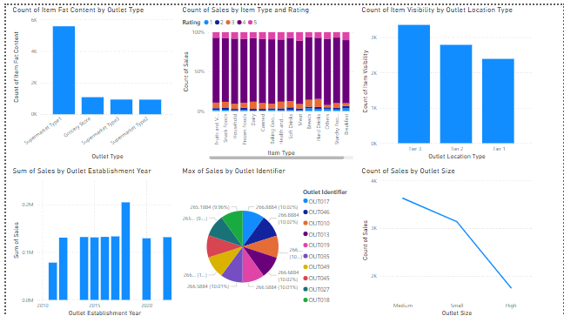

Slide 8
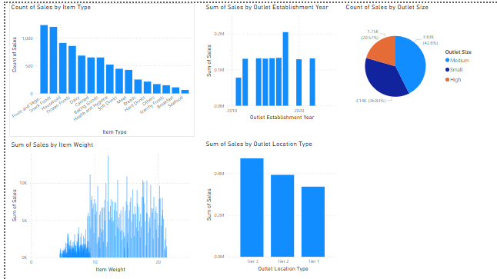

Slide 9
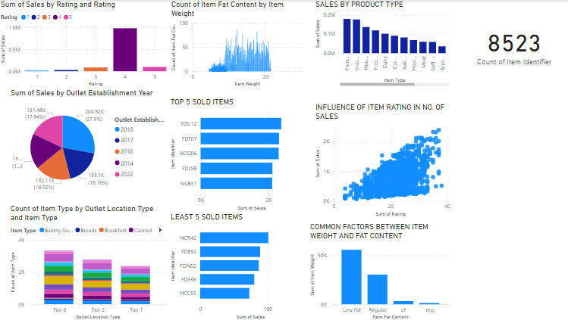

Slide 10
THANK YOU

